Slide 1
Electricity Bill Payment KIOSK

Slide 2
Overview
About i~Easypay
Development & deployment of windows and Web Bases Application for Electricity Bill Payment KIOSK with support.
Start Date | 26-Oct-2016 |  | End Date | 23-Feb-2017
Technologies Used | Asp. Net, Oracle 12C |  | Skillset Used | C#, Asp. Net, Java Script, SQL
Project Life Cycle | Waterfall |  | Team Size | 5
Client | BESCOM
Project Manager | Nithin G

Slide 3
Project Team Structure
PM
HR
IT
PL
Developer
Developer
System Admin
MD
PL
Developer
Developer
QA
QA

Slide 4
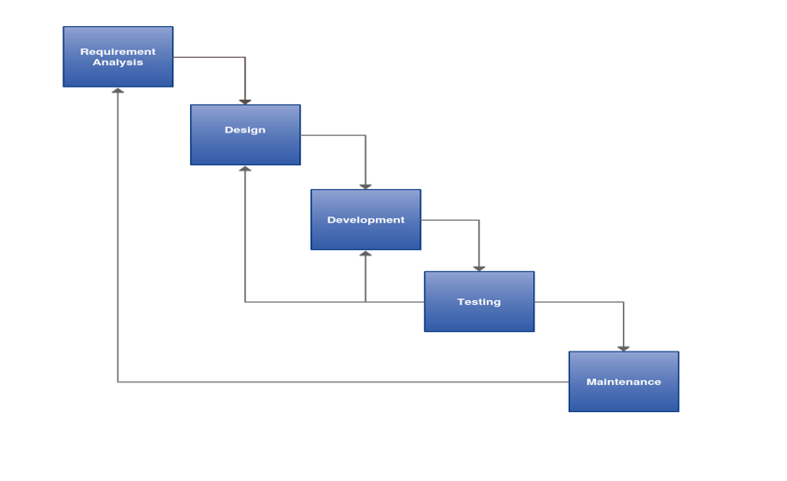
Project Life Cycle

Slide 5
Project Objective
The objective of this project is to Development and deployment of Windows and Web Based customized software integrated with ATP (Anytime Payment Machine) to deliver solutions for the bill payment system along with support and maintenance

Slide 6
Project Scope
In Scope
This ATP Machine should support all the Payments Customized software to cater for your bill payment solutions Very User friendly interface designed keeping all category of end users into consideration Highly secured and advance ATP machines for high speed performance Ability to accept cash, cheque, DD and card for bill payment Ability to function in both online and offline mode Ability to switch to operator mode on needy basis Multilevel securities (password, Biometric system, OTP) to access the ATP cash box, remit cash and for other accesses

Slide 7
Project Scope
In Scope
This ATP Machine should support all the Payments Ability to delivery receipts, as well as SMS confirmation of the payment made to the consumer Scanning the cheque for details like cheque number and MICR code prior accepting it. Fake note and cheque detectors in ATP machines Ability to accept payment for all locations under the organization. Web interface to verify and accept cash by the cash officer Customized reports to evaluate/asses and plan for long time performance of the organization

Slide 8
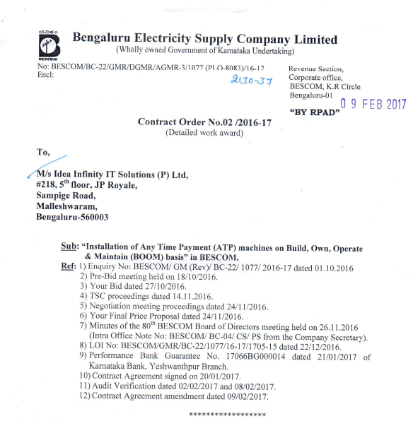
Work Order

Slide 9
Stakeholders
Internal Stakeholders
Idea Infinity Management Department
Mr.Ramesh K S
Vinay
Deepak
Vrushank
External Stakeholder
BESC Authorities

Slide 10
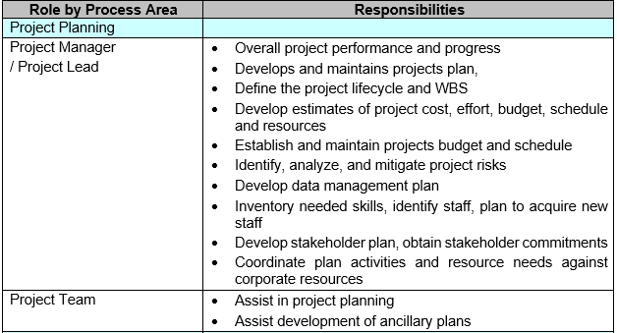
Roles & Responsibilities - Project Planning

Slide 11
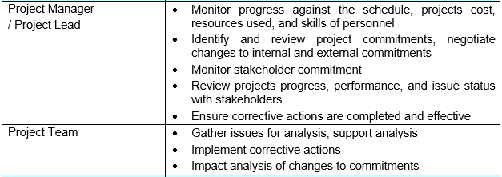
Roles & Responsibilities - Project Monitoring & Control

Slide 12
Roles & Responsibilities - Technical Activities

Slide 13
Requirement Management Plan

Slide 14
Requirements Traceability Matrix - RTM

Slide 15
Test Plan

Slide 16
RACI Chart

Slide 17
Project Planning – Gantt Chart (Actual)

Slide 18
Project Planning - Skill Gap Analysis

Slide 19
Project Planning - Milestones & Deliverables

Slide 20
Project Planning - Team

Slide 21
Project Planning – Work Environment

Slide 22
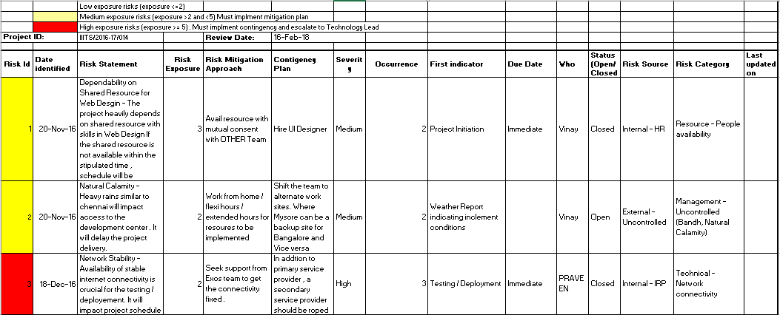
Risk Management

Slide 23
Configuration Management

Slide 24
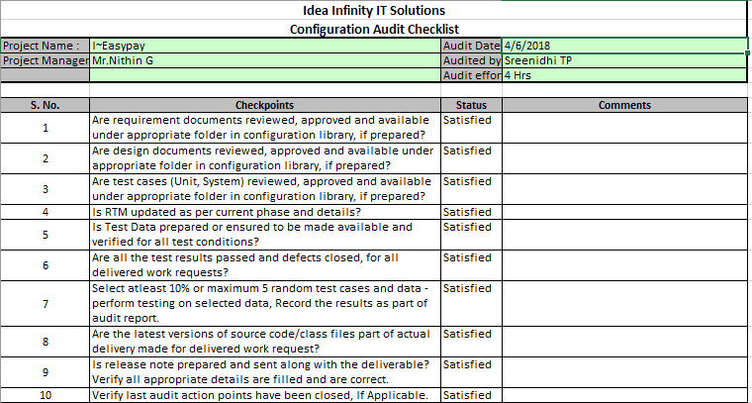
CM Audit – Checklist

Slide 25
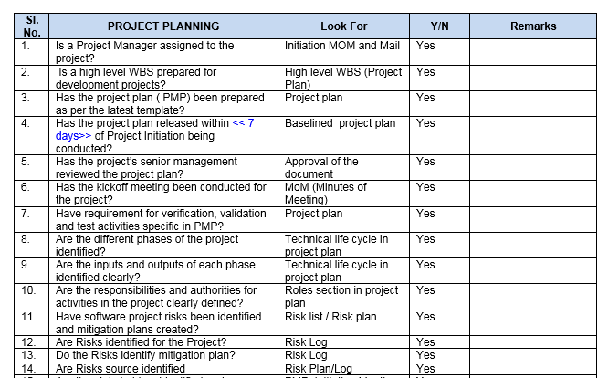
Project Monitoring - PPQA

Slide 26
Design – Code Review

Slide 27
Change Management

Slide 28
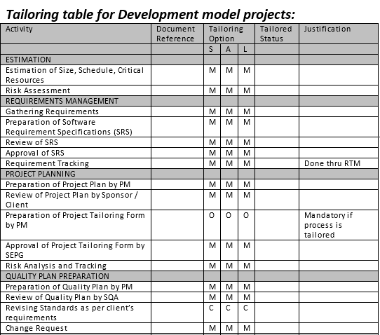
Tailoring

Slide 29
Decision Analysis and Resolution

Slide 30
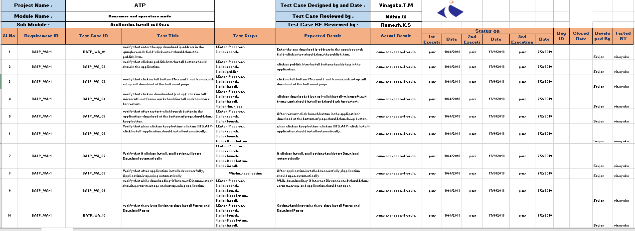
Test cases

Slide 31
Metrics Report

Slide 32
Best Practice

Slide 33
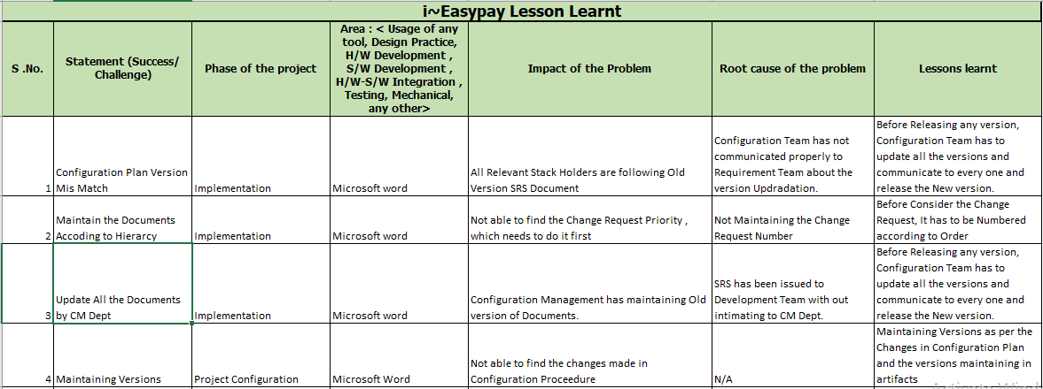
Lesson Learnt

Slide 34
Customer Feedback

Slide 35
Thank You

